Slide 1
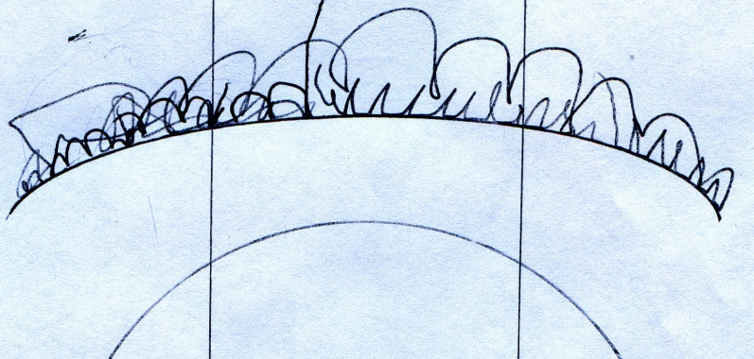
Praxim Haptic 3D Surface Emulation
Erica Wodzak
Davy Chiu
David Mountford
Ibrahim Gadala
Nicholas Adams

Slide 2
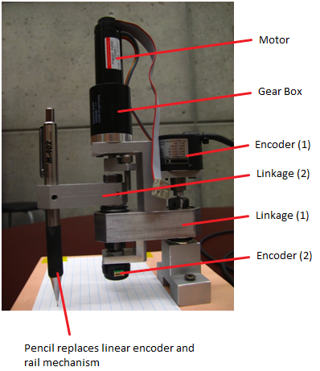
Outline
Background
Dynamic Constraint Concept
Functional Decomposition
Concepts Generation
Concept Selection

Slide 3
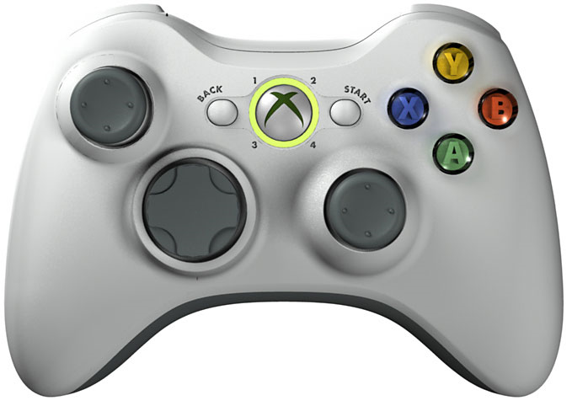
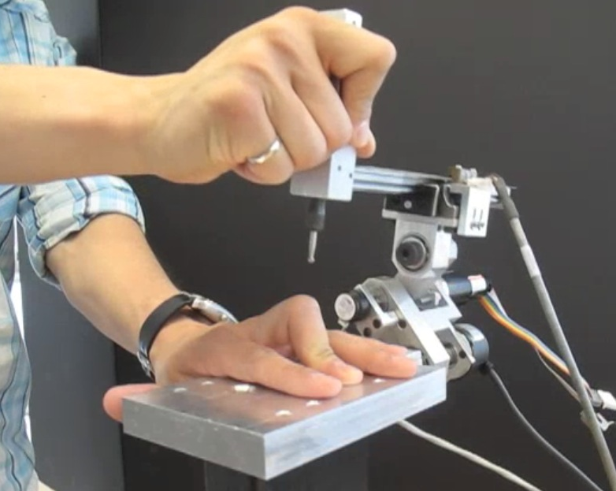
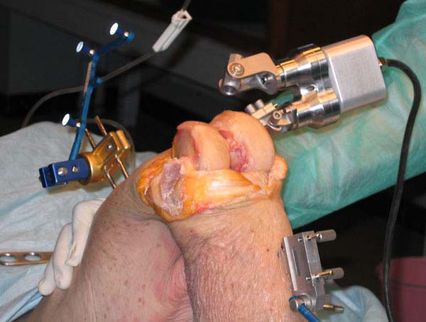
Project Background

Slide 4
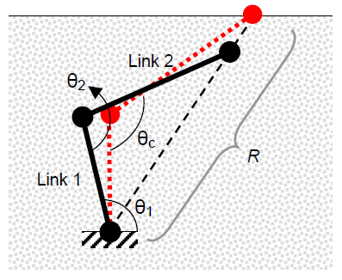
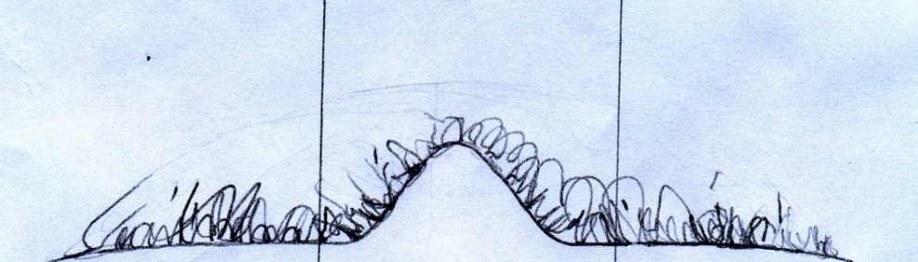
Dynamic Physical Constraint Concept

Slide 5
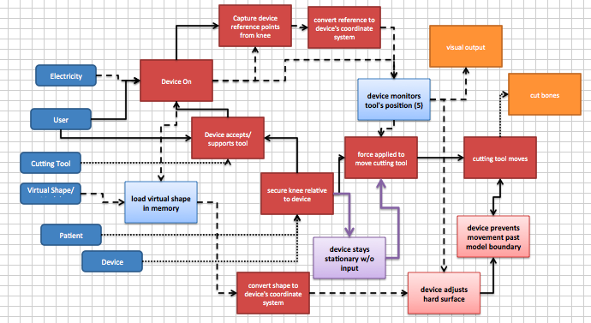
Functional Decomposition

Slide 6
Functional Decomposition
Device Stays In Position Under Gravitational Influence

Slide 7
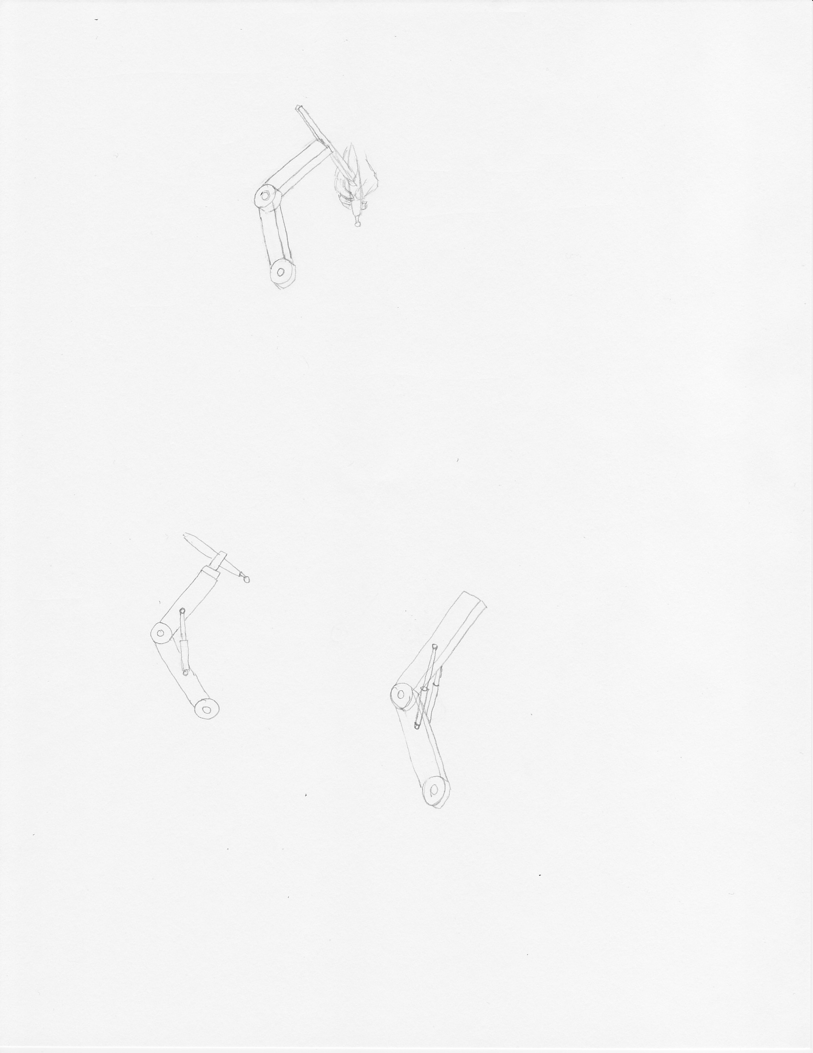
Concept Generation: High Joint Friction
Joint friction equal to arm’s free weight

Slide 8
Concept Generation: High Joint Friction
Hydraulic damper resisting arm’s weight

